Slide 1
Atoms: Independent Practice (INB 46)
Each element is made of groups of a single type of atom.
Atoms are made of _____, _______ and _____ which are subatomic particles.
The atomic number is the number of protons in the nucleus.
Every element has a certain number of protons in its nucleus. The number of protons is element’s unique fingerprint- unique identity.

Slide 2
Nucleus
Central part of the atom
Contains most of atom’s ______ (extremely dense)
_______ move rapidly around it
Made of protons and ________
It is positively charged as it contains a proton (+ charge) and a neutron (0 charge).

Slide 3
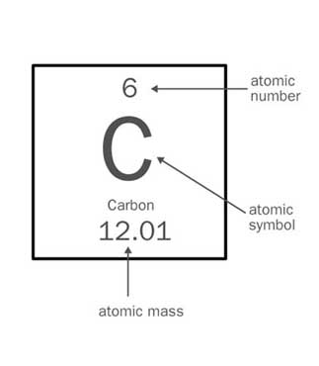
On the bottom of page 46
Write what the atomic # is and the atomic mass # is after drawing this.
Using your textbook, turn to page 78 and draw the model of an atom.
Homework: Review Notes and complete drawing

Slide 4
Vocabulary Words for K.I.M chart INB 50
Matter Atom
Neutron Electron
Proton Element
Compound Particle
Pure substance Atomic number
Atomic mass Substance
Valence electron Chemical bond

Slide 5
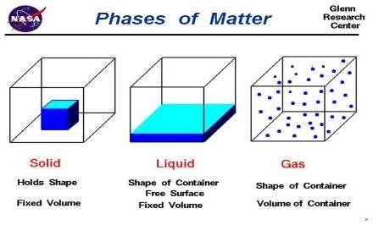
Keyword (term) | Information (definition) | Memory Clue (Picture, definition in own words, synonym)
Matter | Anything that has mass and takes up space

